Slide 2
What is a resume?
Formal document that provides an overview of your professional qualifications.
Relevant work experience
Skills
Education
Notable accomplishments
Helps convince employers you’re worth interviewing
Helps with college admissions and scholarships

Slide 3
Why is a resume important?
A resume advertises YOU!!!
Just like a clothing companies spend time and money on designing their advertising campaign. You must spend a lot of time creating, proofreading, editing, and perfecting your resume.
A resume may be the most important pieces of writing/work you will ever create!
A great resume will open the door to potential job opportunities.
WORK HARD ON YOUR RESUME!

Slide 4
Resume components
Your resume is made up of the following features:
Heading
Objective
Education
Experience
Activities
Skills
References

Slide 5
Heading
Your heading should include your personal information
Formal name (no nicknames)
Address (you can use your full address or just city and state)
Phone number
E-mail

Slide 6
Objective
It’s generally a one sentence explanation of the job you are seeking.
Your objective should be specific
If you are applying for different jobs, change your objective to be specific to each job.
Example: Seeking a position as an administrative assistant at ABC Inc., to leverage organizational and research skills to support internal and external communication.
Example: Aiming to secure an entry-level position to gain practical accounting experience with the finance team at ABC & Co.

Slide 7
Education
List schools you have attended (high school and beyond)
If you are in college, you will NOT need to list your high school
Specify dates of attendance or anticipated graduation date
College students: Include major and the degree you received or expected to receive.
Depending on the job, you may want to include relevant courses.
Including your GPA is dependent on your job and how long you’ve been out of college. DO NOT INCLUDE GPA’S LOWER THAN 3.0

Slide 8
This section should include PREVIOUS EMPLOYERS, THEIR LOCATIONS, DATES OF EMPLOYMENT, and YOUR JOB TITLE.
You should include at minimum three lines/bullets of your job duties and responsibilities.
You can not assume your job title explains what you did.
Use POWER VERBS in your job descriptions.
Avoid “I” in your descriptions.

Slide 9
POWER/ACTION WORDS FOR JOB RESPONSIBILITIES
You want to use GREAT action words to describe your job responsibilities
Use them sparingly, one POWER verb per bullet point

Slide 10
ACTIVITIES
Employers like to see that you are involved in school or community activities.
List any special activities you participated in and organizations you joined.
Special Activities: Relay for Life, Prom Committee
Organizations: Band, Choir, Drama, Sports, FFA, DECA, FBLA, Student Council, etc.
Add years of participation
As you get older, including an activities section may become irrelevant with the more job experience you have

Slide 11
Skills
Use the skills section to include special skills or talents that are not included elsewhere, but a relevant for the position you are applying for.
Technical Skills: Microsoft office, google drive, social media, web, email, etc
Professional Skills: Computer proficiency, leadership experience, people skills, etc.

Slide 12
References
You should have people who have observed your work habits (employers, Teachers, coaches, etc) or people who have observed your character
Only ask people who will speak highly of you
Get permission from potential references BEFORE you give someone their name.
You do not need to list references on your resume
At the bottom of your resume, you can put “References available upon request”
Create a sheet with references names, addresses, employers, job titles, and phone numbers for when this may be asked of you.

Slide 13
Format
Your resume will be formatted in reverse chronological order.
This follows your most recent work history to oldest
Format with consistency
1-2 fonts on your resume
Fonts should be no smaller than 8 point – 10 point preferred
Sections should be clearly divided
Resumes typically don’t use complete sentences
Instead use action phrases

Slide 14
Questions
How long do employers usually look at a resume?
Less than 30 seconds
3 minutes
1 minute

Slide 15
Questions
How long do employers usually look at a resume?
Less than 30 seconds
Employers receive hundreds of resumes
Little details are important!!!!

Slide 16
Tips & Suggestions
Look at resumes for the same job to get an idea – DO NOT COPY & PASTE SOMEONE ELSE’S RESUME
Be concise, factual, and positive
Your resume must be PERFECT
It only takes one error in spelling, punctuation, grammar, or formatting to have an employer toss your resume
PROOFREAD, PROOFREAD, PROOFREAD
Go over it with a fine-tooth comb
NEVER submit a resume without having someone else look it over
Limit your resume to 1 page

Slide 17
Tips & Suggestions
If you have little work experience you will need to highlight your accomplishments in an out of the classroom.
Volunteer activities, hobbies, sports, clubs, awards
Look at the job description/listing and present your objective in a manner that relates to that.
Job description is also a great place to look for what the company is looking for in that position and you can use some of those action words in your resume
SELL YOURSELF – Separate yourself from other applicants
TELL THE TRUTH

Slide 19
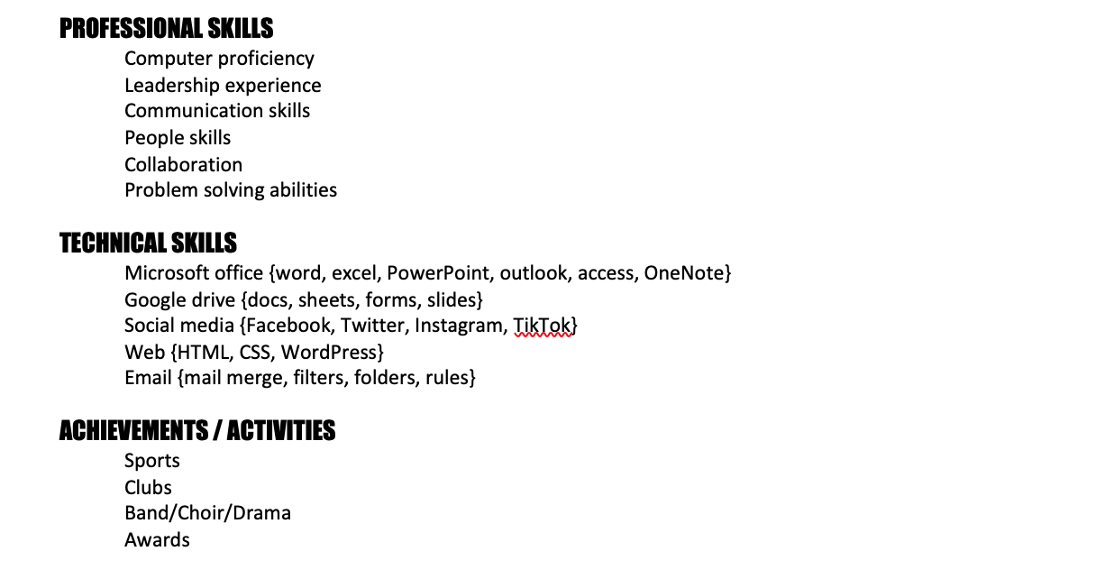

Slide 20
TERMS OF USE
•All slides in this product are copyrighted. You may not create anything to sell, or share based on this packet.
•This packet is for one teacher use only. Do not share with colleagues. If they like the product, please send them to my TPT store. TPT is about educators supporting educators.
•You are permitted to share the cover image of this product on your blog or via social media if you link back to my blog post showcasing the product or the product link on TPT

